Slide 1


Slide 2

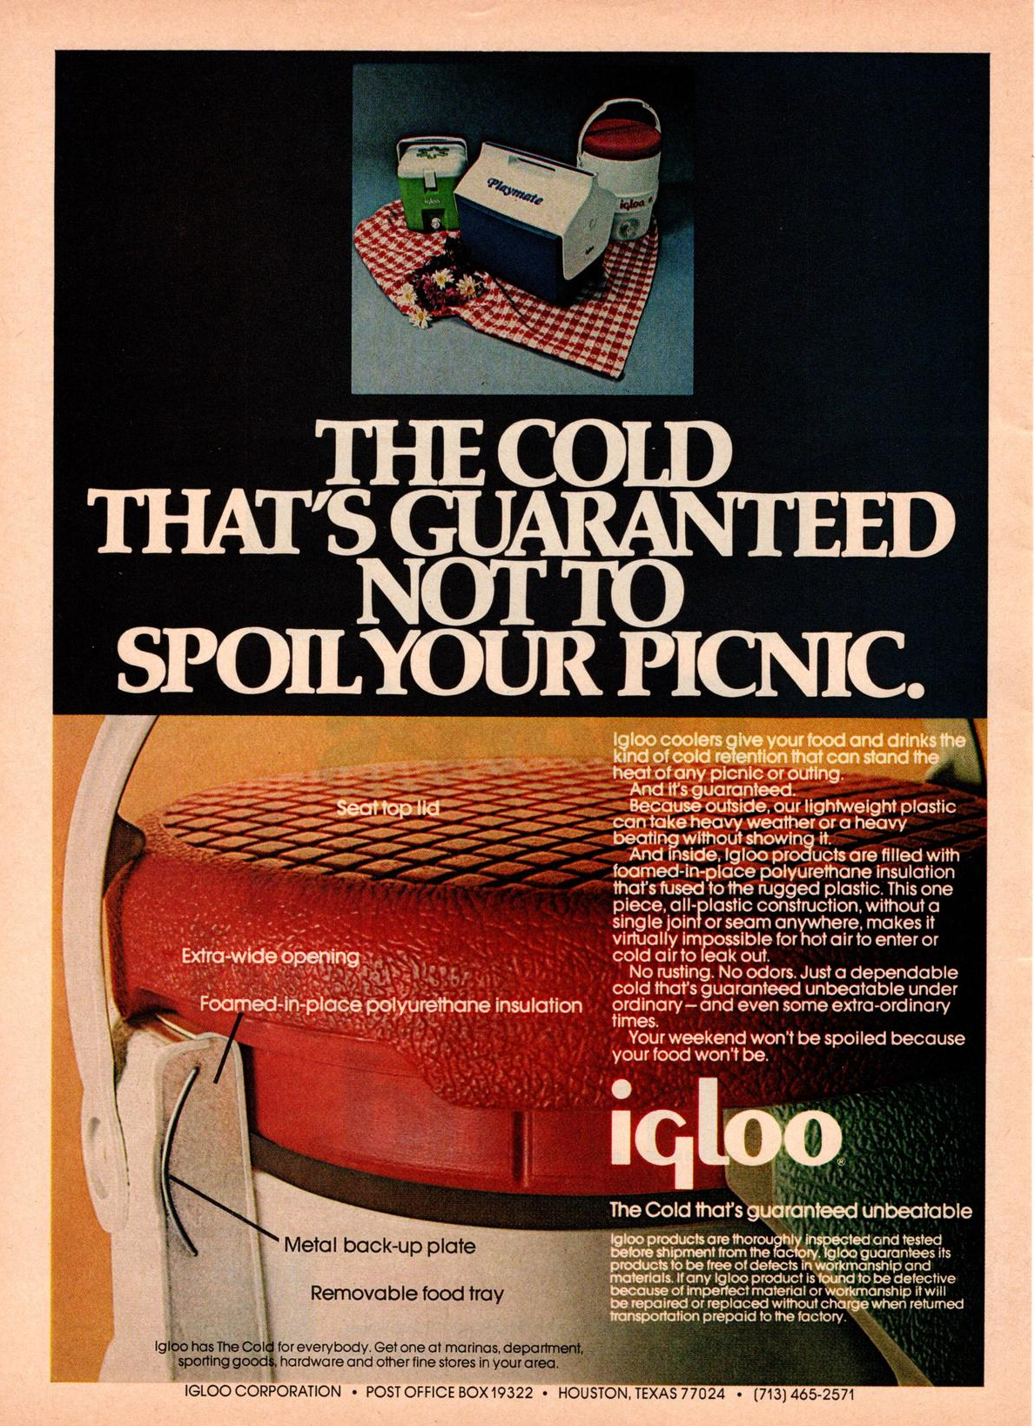
IGLOO HISTORY
Born from a modest metalworking shop back in 1947, Igloo has been instrumental in redefining how we live, work and play.
What began with bringing clean water to the worksite quickly moved into super-functional, best in class ice chests.
Igloo products made the family outdoor recreation movement of the 20th century possible.
Suddenly, taking your kids camping on the weekend became easy and cross-country roadtrips became a summer vacation staple.
As we approach our next century, Igloo is 1200 employees strong.
We are proud to call—a 1.8 million square-foot, three-building facility in—Katy, Texas home.
More than 500 products sold at Thouands of retailers around the globe, we can confidently call ourselves the number one cooler manufacturer in the world.
And through it all we haven’t lost sight of our original goal—to create products that enable the pursuit of happiness (however you define it). That’s why we’re still working hard every day to innovate, create, and make it easier for you to get out, work hard and play even harder.

Slide 4
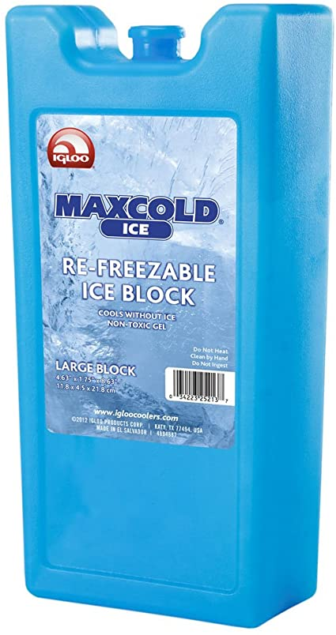
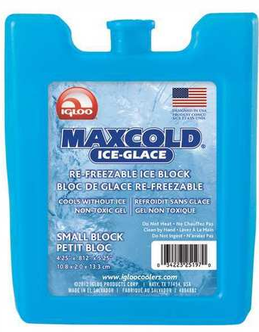
ICE BLOCKS
5.25 JD’s
2.00 JD’s

Slide 5
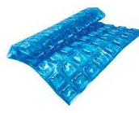
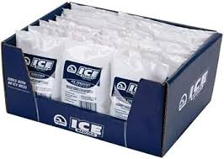

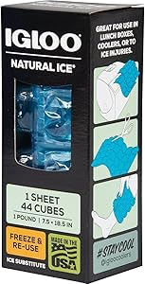
ICE BLOCKS
2.75 JD’s
7.50 JD’s
About this item
* Uses non-toxic Ultratherm gel for extended cooling performance
* Each reusable pouch contains 8-ounces of freezable gel
* Soft pouch molds to fit around items for localized intense cold
Item Code: IGL/25078
Item Desc: Igloo Natural Ice Sheet 44 Cube
VAT: 16%
RP: 7.50
MOQ: 6 Pack: 6 Case: 6
Item Code: IGL/25076
Item Desc: Igloo Ice Soft Gel Pack
VAT: 16%
RP: 2.75
MOQ: 12 Pack: 12 Case:12

Slide 7
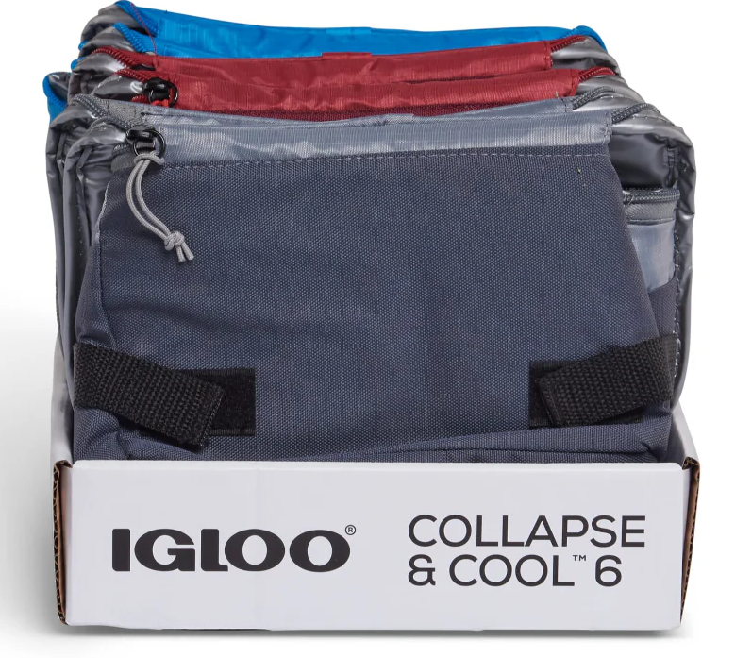
COLLAPSE & COOL 6
Item Code: IGL/66484
Item Desc: Igloo Collapse & Cool 6 Solid Assortment
VAT: 16%
RP: 16.00
MOQ: 6 Pack: 6 Case: 6
16.00 JD’s

Slide 8
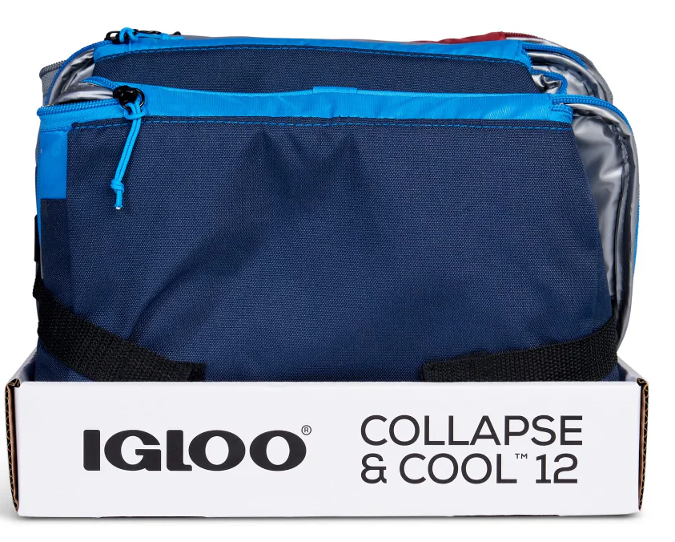
COLLAPSE & COOL 12
Item Code: IGL/66485
Item Desc: Igloo Collapse & Cool 12 Solid Assortment
VAT: 16%
RP: 19.00
MOQ: 6 Pack: 6 Case: 6
19.00 JD’s

Slide 9
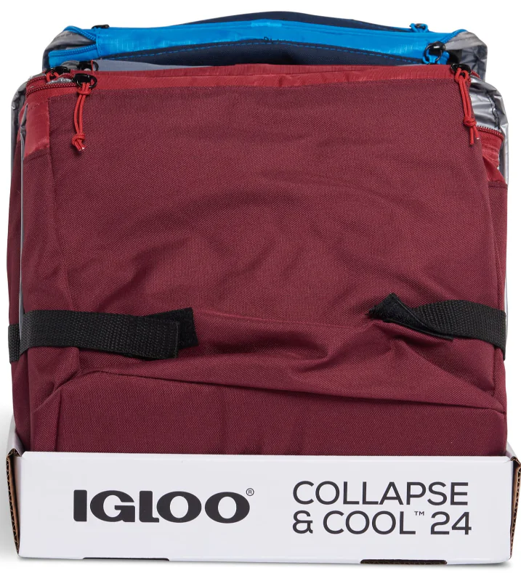
COLLAPSE & COOL 24
Item Code: IGL/66486
Item Desc: Igloo Collapse & Cool 24 Solid Assortment
VAT: 16%
RP: 22.00
MOQ: 6 Pack: 6 Case: 6
22.00 JD’s

Slide 10
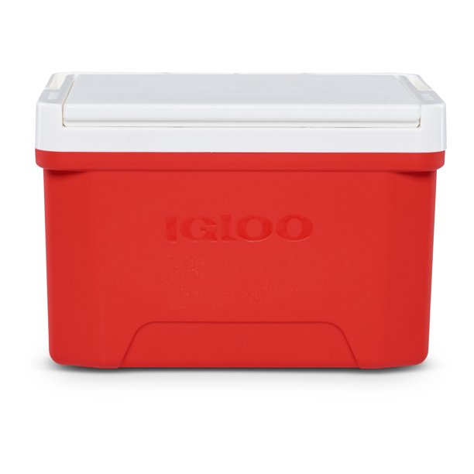
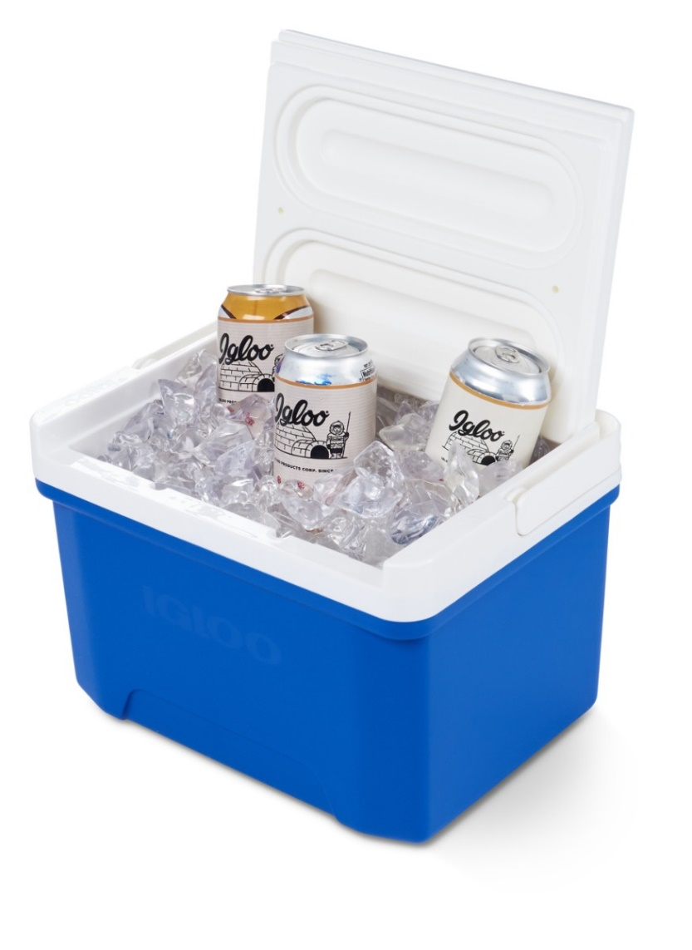
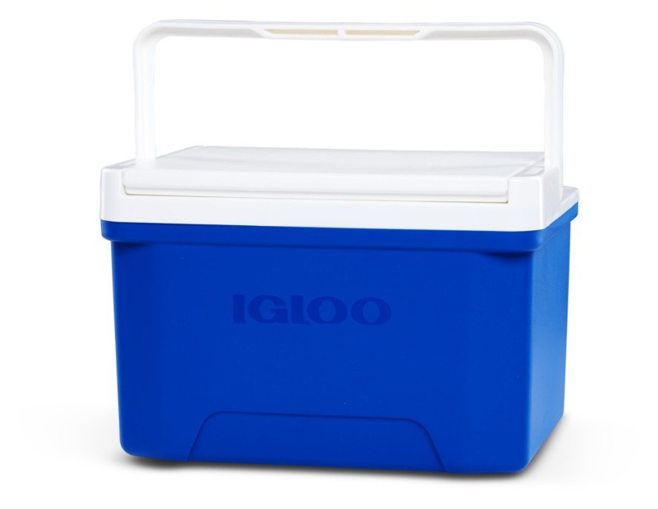
LAGUNA COOLER 9
Specifications:
Cool Riser Technology® – elevated design improves cooling performance
Integrated bale handle for one-handed carrying, and folds flat for storage
Lid reverses from flat surface to tray and cup holder
Designed for easy stacking and storage
Easy-clean, stain and odor resistant liner
NEW THERMECOOL™ Foam – Cleaner ECO
friendly solution
Size:
9 Quarts / 8 Liters / 13 Cans
Case Pack: 4
22.00 JD’s

Slide 11
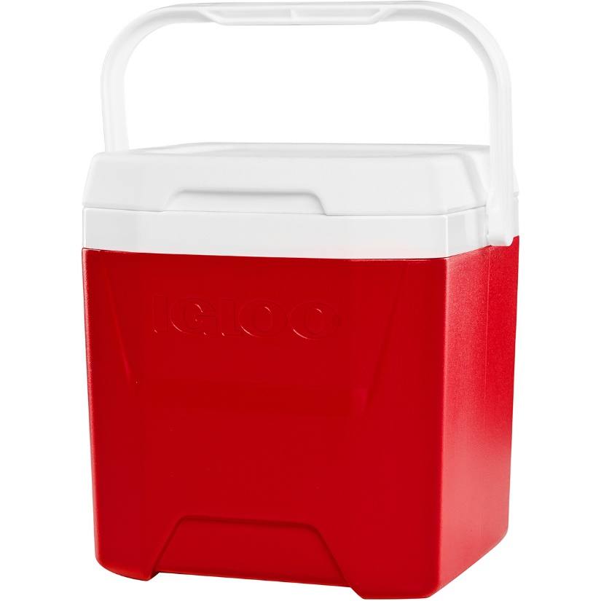
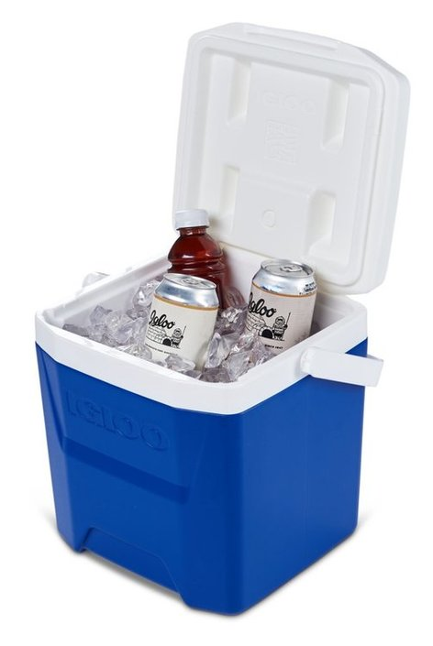
LAGUNA COOLER 12
Specifications:
Cool Riser Technology® – elevated design improves cooling performance
Integrated “pouring channels” in liner allow for
easy purging of melted ice
Ergonomic curved backside – more comfortable to carry
Vertical profile fits tall bottles and longnecks
NEW THERMECOOL™ Foam – Cleaner ECO
friendly solution
Size:
12 Quarts / 11 Liters / 18 Cans
Case Pack: 2
29.75 JD’s

Slide 12
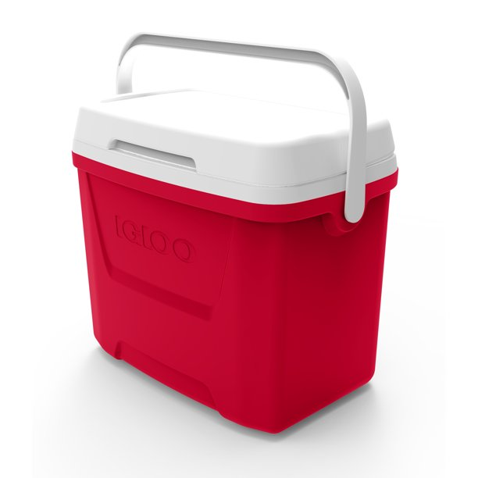
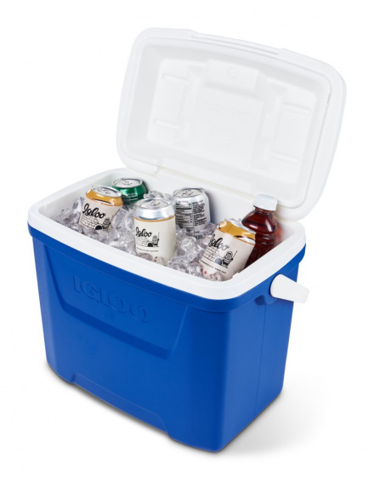
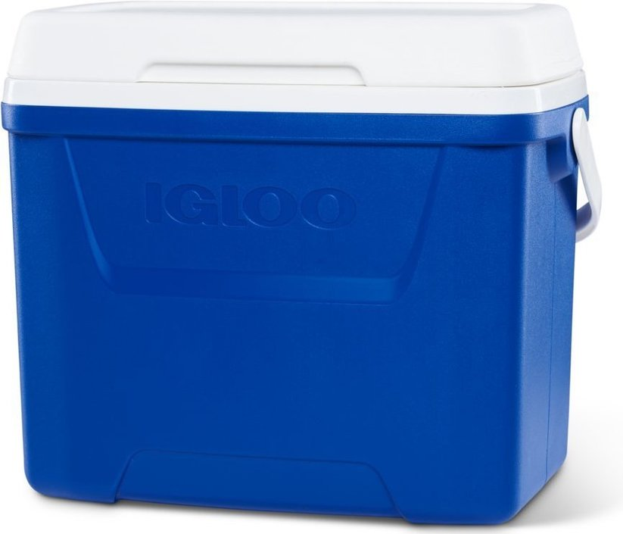
LAGUNA COOLER 28
Specifications:
Cool Riser Technology® – elevated design improves cooling performance
Swing-up handle for one-handed carrying
Curved backside hugs comfortably to your body for ultimate carrying comfort
NEW THERMECOOL™ Foam – Cleaner ECO
friendly solution
Size:
28 Quarts / 26 Liters / 42 Cans
Case Pack: 2
37.50 JD’s

Slide 13
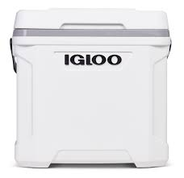
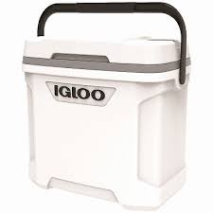
LATITUDE Marine 30
80.00 JD’s
Item Code: IGL/50557
Item Desc: Igloo Latitude Marine Ultra 30 QT (28 Liters)
RP: 80.00
VAT: 16%
MOQ: 1 Pack: 1 Case: 1

Slide 14
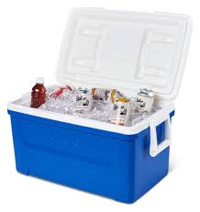
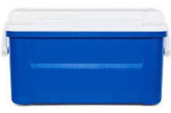
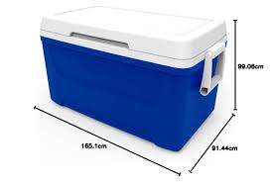
LAGUNA COOLER 48
Specifications:
Cool Riser Technology® – elevated design improves cooling performance
Insulated with Ultratherm™ foam to keep contents cold
Swing-up carry handles
Stain and odor-resistant liner
NEW THERMECOOL™ Foam – Cleaner ECO friendly solution
Size:
48 Quarts / 45 Liters / 76 Cans
Case Pack: 2
50.00 JD’s

Slide 15
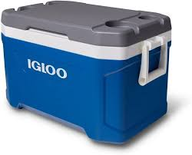
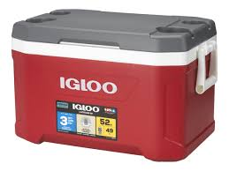
LATITUDE 52
75.00 JD’s
Item Code: IGL/50338
Item Desc: Igloo Ice Box Latitude 52 Blue (50 Liters)
RP: 75.00
VAT: 16%
MOQ: 1 Pack: 1 Case: 1
Item Code: IGL/50340
Item Desc: Igloo Ice Box Latitude 52 Red (50 Liters)
RP: 75.00
VAT: 16%
MOQ: 1 Pack: 1 Case: 1

Slide 16
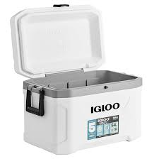
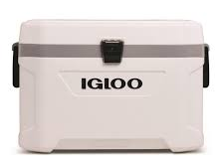
LATITUDE Marine 54
Item Code: IGL/50541
Item Desc: Igloo Latitude Marine Ultra 54 QT (51 Liters)
RP: 120.00
VAT: 16%
MOQ: 1 Pack: 1 Case: 1
120.00 JD’s

Slide 17
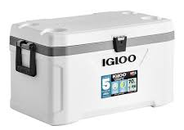
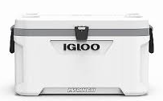
LATITUDE Marine 70
Item Code: IGL/50548
Item Desc: Igloo Latitude Marine Ultra 70 QT (66 Liters)
RP: 160.00
VAT: 16%
MOQ: 1 Pack: 1 Case: 1
160.00 JD’s

Slide 18
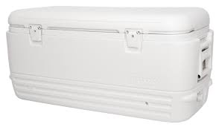
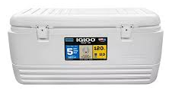
POLAR COOLER 120
Item Code: IGL/44577
Item Desc: Igloo Polar 120 QT White (113 Liters)
VAT: 16%
MOQ: 1 Pack: 1 Case: 1
150.00 JD’s

Slide 19
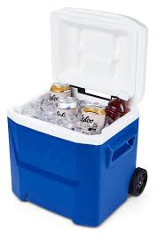
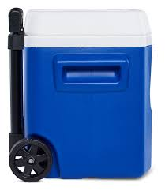
LAGUNA COOLER 16 ROLLER
Specifications:
Fits 24 Cans stacked in natural columns
Locking Telescoping Handle can be pushed or pulled
NASCAR Compliant
Molded Scoop Handles
Cool Riser Technology®- elevated design
improves cooling performance NEW
Size:
16 Quarts / 15 Liters / 24 Cans
Case Pack: 2
52.00 JD’s

Slide 20
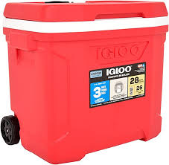
PROFILER COOLER 28 ROLLER
62.00 JD’s
Item Code: IGL/34673
Item Desc: Igloo Profiler 28 QT Roller Blue (26.5 Liters)
VAT: 16%
MOQ: 1 Pack: 2 Case: 2
Item Code: IGL/34675
Item Desc: Igloo Profiler 28 QT Roller Red (26.5 Liters)
VAT: 16%
MOQ: 1 Pack: 2 Case: 2

Slide 21
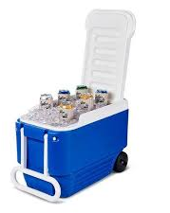
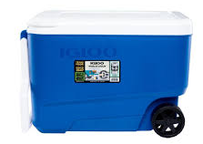
WHEELER COOLER 38 ROLLER
Item Code: IGL/34482
Item Desc: Igloo Wheeler 38 QT Blue (36 Liters)
VAT: 16%
MOQ: 1 Pack: 2 Case: 2
65.00 JD’s

Slide 22
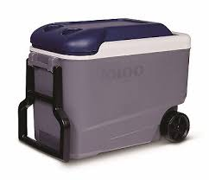
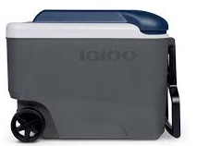
MAXCOLD 40 ROLLER
Item Code: IGL/34226
Item Desc: Igloo Maxcold 40 QT Roller (37.5 Liters)
VAT: 16%
MOQ: 1 Pack: 2 Case: 2
100.00 JD’s

Slide 23
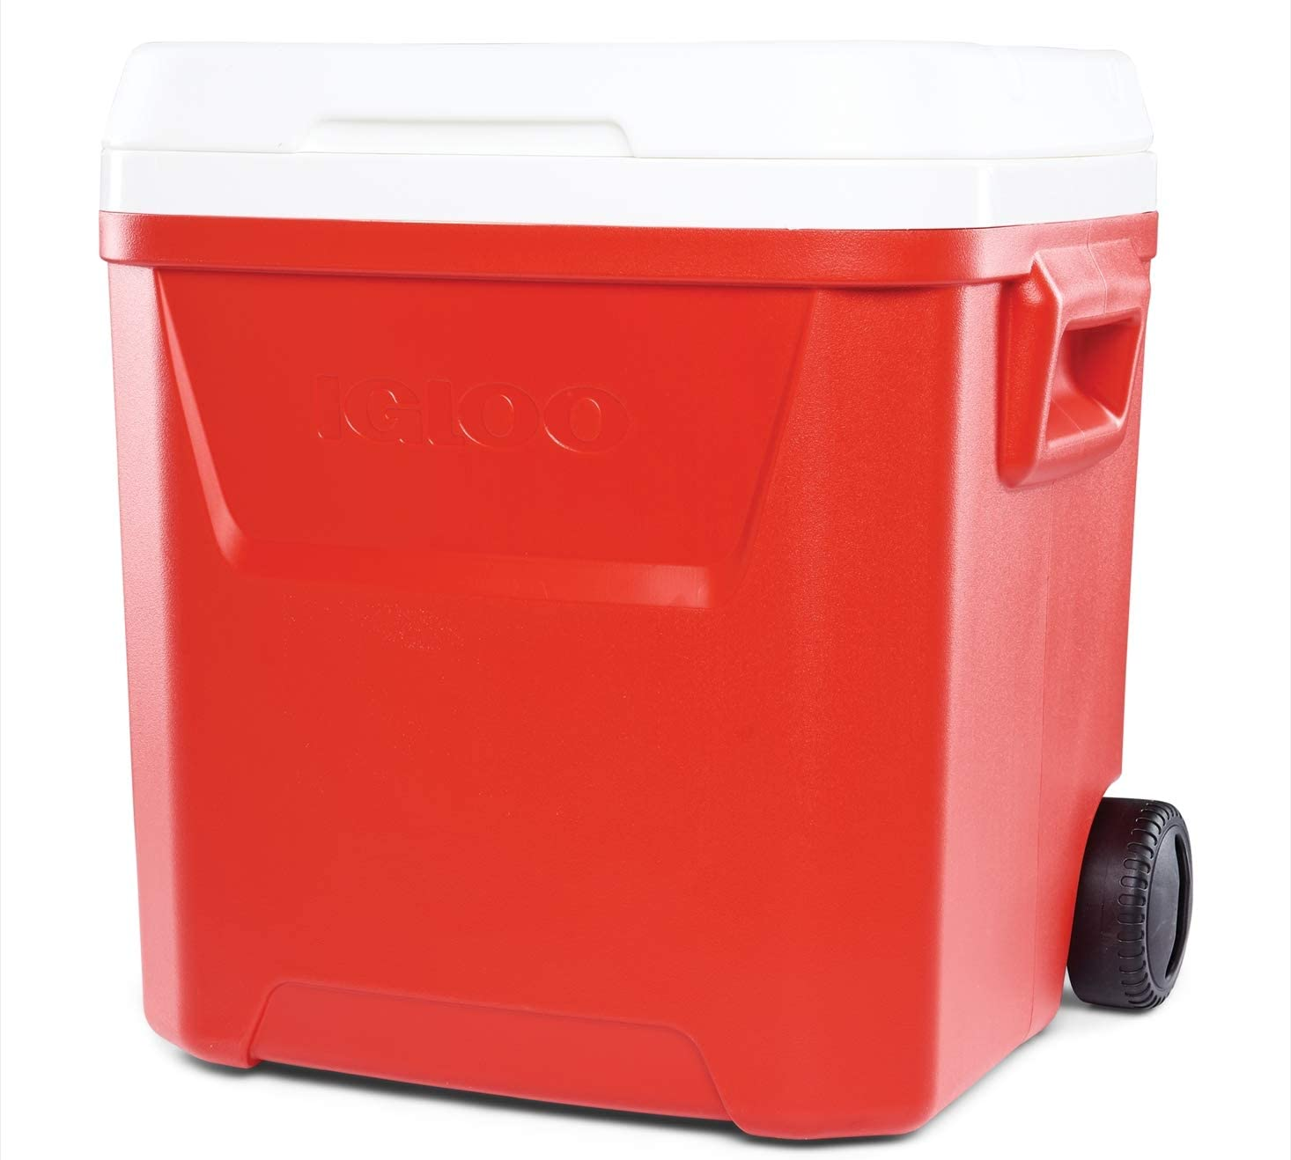
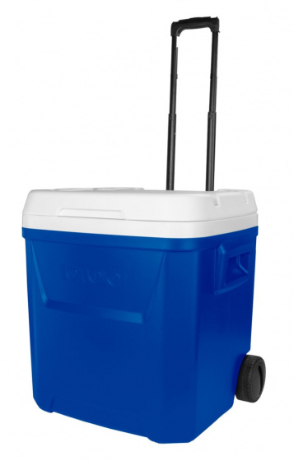
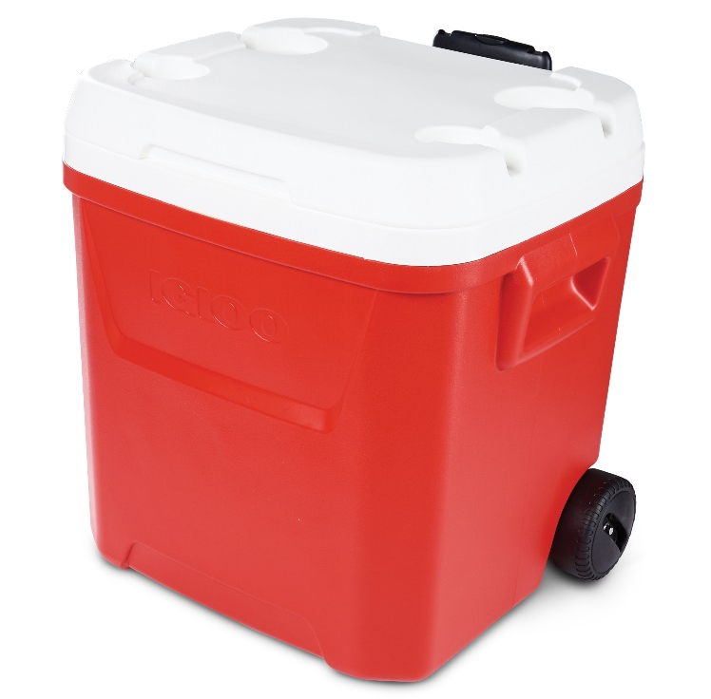
LAGUNA COOLER 60 ROLLER
Specifications:
Wheeled for easy transport
Locking, telescoping handle enables cooler to be pushed or pulled
Molded side handles for lifting in / out of vehicle
Self-draining drink holders keep your beverages within arm’s reach
Two accommodate 12-ounce cans while two fit large personal hydration tumblers
Recessed drain plug makes emptying melted ice a cinch
Cool Riser Technology® – elevated design improves cooling performance
NEW THERMECOOL™ Foam – Cleaner ECO friendly solution
Size:
48 Quarts / 45 Liters / 76 Cans
Case Pack: 2
85.00 JD’s

